Slide 1
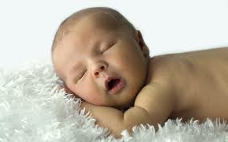
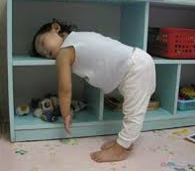
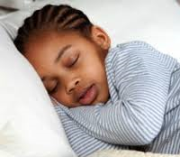
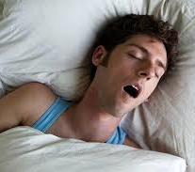
Addressing Sleep Difficulties in Individuals with Developmental Disabilities
Laura Hiruma, Ph.D.
Licensed Psychologist
Clinical Assistant Professor
UNC Carolina Institute for Developmental Disabilities

Slide 2
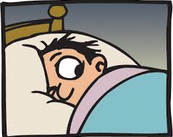
Objectives
By the end of today’s discussion, you should be familiar with:
Basic understanding of sleep mechanisms
Sleep problems common in individuals with IDDs
Sleep screening and assessment
Sleep interventions
Resources for practitioners and families

Slide 3
Significance of Sleep
Emotional Difficulties
Behavioral Challenges
Cognitive Dysfunction
Health & Immunity
Sleep Problems
Notes:
Sleep deprivation in rat models leads to infection and death
Lack of sleep eventually results in sleep deprivation or “sleep debt” characterized by diminished judgement, reaction time, and other functional impairments.
Extreme sleep deprivation in humans can impact judgment, emotion regulation, and even induce psychotic-like states in otherwise healthy people (e.g., mania, paranoia, hallucinations).

Slide 4
Significance of Sleep
Emotional Difficulties
Functional Impairments
Behavioral Challenges
Cognitive Dysfunction
Family Distress
Health & Immunity
Sleep Problems

Slide 5
Significance of Sleep
Emotional Difficulties
Behavioral Challenges
Cognitive Dysfunction
Health & Immunity
Sleep Problems

Slide 6
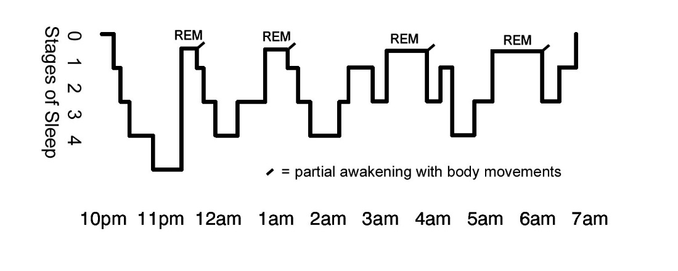
Sleep Basics: Sleep Cycles
www.intropsych.com
Five Stages of Sleep:
Stage 1: light sleep, drifting, hypnic myoclonia (reflex)
Stage 2: 50% of sleep time, brain wave slowing, sleep spindles
Stage 3: Start of restorative deep sleep, slowed delta waves, waking is difficulty
Stage 4: Continued restorative deep sleep, mostly delta waves, refreshing
REM: 20% of sleep time, active/dream stage, increases in morning
Notes:
Average adults go through 4-5 sleep cycles (90 min each) nightly
Infants go through 8-10 sleep cycles (50 min each) nightly and spend less time in deep sleep
It’s normal to wake several times throughout the night, but most people fall back asleep right away.
Nighttime awakenings become problematic when individuals have trouble re-initiating sleep or when they require certain stimulus (such as a caregiver) to fall back asleep.
Deep sleep (stages 3 & 4): necessary for healing, growth, and immunity; During deep sleep stages, it is difficult to wake others, bedwetting and night terrors may occur; Deep sleep also coincides with the release of growth hormones in the body.
REM sleep: dreaming, contributes to brain development in addition to non-REM sleep (learning and memory); Takes most people about 70 to 90 minutes to get to first REM sleep period

Slide 7
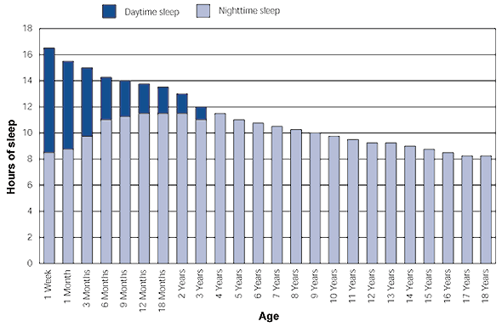
Sleep Basics: Developmental Patterns
Change in Hours of Daytime and Nighttime Sleep with Increasing Age
Thiedke, C.C. (2001). Sleep disorders and sleep problems in childhood. American Family Physician, 15, 277-285.
Notes:
Keep in mind, typically-developing school-age children generally require 10-11 hours of sleep; however, people with developmental disabilities tend to sleep less (due to disordered sleep and less sleep need)
General Sleep Needs:
Infants = 16 hours per day
School-Age children = around 10 hours
Teens = 9 hours
Adults = 7 to 8 hours (although range can be 5 to 10 in population), pregnant women often need more
Ability to stay in deep sleep for longer diminishes with age; about 50% of people over 65 experience recurrent sleep difficulties

Slide 8
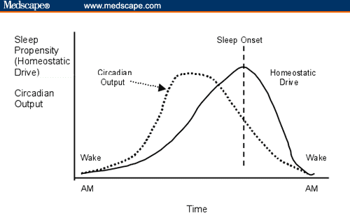
Sleep Basics: Circadian Rhythm and Homeostatic Drive
www.medscape.com
Notes:
Graphic shows two principle modulators of sleep and wakefulness
Circadian rhythm = body’s biological clock is driven by the body’s suprachiasmatic nucleus (SCN, tiny structure of the brain) that sends signals to your pineal gland relates to melatonin.
This structure responds to light (absorbed through the retina) and switches OFF production of melatonin hormone in your body during day. Melatonin increases when it is dark outside to induce drowsiness. Light cues and melatonin are important for keeping internal clock in check (which is why people with total blindness are prone to sleep problems).
Natural circadian rhythm of hormones affecting sleep can influence timing of sleep onset. There are natural early birds and night owls.
During adolescence, circadian shift occurs due to hormone changes, meaning teens have natural propensity to be “night owls”—developmental mismatch with many high school schedules.
Disruption to our internal clock can be a big deal, this is essentially what happens when we experience jet lag.
Homeostatic drive (need for sleep) also builds throughout the day (the longer you go without the sleep).

Slide 9
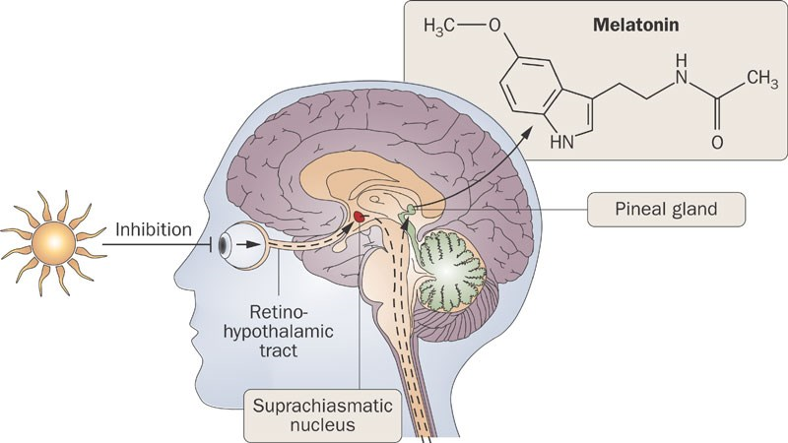
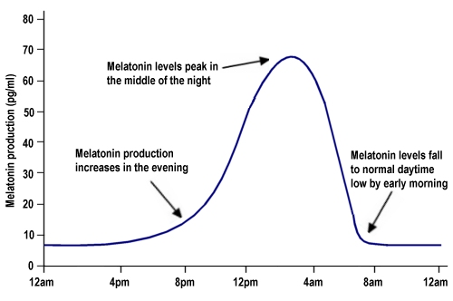
Sleep Basics: Melatonin
https://www.howsleepworks.com/images/melatonin.jpg
Bubenik, G. A. J. Physiol. Pharmacol. 58 (Suppl. 6), 23–52 (2007).
Notes:
Graphic shows two principle modulators of sleep and wakefulness
Circadian rhythm = body’s biological clock is driven by the body’s suprachiasmatic nucleus (SCN, tiny structure of the brain) that sends signals to your pineal gland relates to melatonin.
This structure responds to light (absorbed through the retina) and switches OFF production of melatonin hormone in your body during day. Melatonin increases when it is dark outside to induce drowsiness. Light cues and melatonin are important for keeping internal clock in check (which is why people with total blindness are prone to sleep problems).
Natural circadian rhythm of hormones affecting sleep can influence timing of sleep onset. There are natural early birds and night owls.
During adolescence, circadian shift occurs due to hormone changes, meaning teens have natural propensity to be “night owls”—developmental mismatch with many high school schedules.
Disruption to our internal clock can be a big deal, this is essentially what happens when we experience jet lag.
Homeostatic drive (need for sleep) also builds throughout the day (the longer you go without the sleep).

Slide 10
Sleep Disturbances
Dyssomnias: difficulty initiating or maintaining sleep, excessive daytime sleepiness
Insomnia
Hypersomnia
Circadian rhythm problems
Breathing-related disorders
Narcolepsy
Restless legs syndrome
Parasomnias: disruption of sleep state resulting in full or partial arousals from sleep
Sleep bruxism
Sleep enuresis
Sleep walking
Night terrors
Notes:
Two main classifications in previous diagnostic schemes
Parasomnias common among typically developing youth, transient

Slide 11
Prevalence
Higher co-occurrence of sleep disorders among individuals with:
Attention deficit hyperactivity disorder (ADHD)
Gastroesophageal reflux disease (GERD)
Autism spectrum disorder
Intellectual disability
Down syndrome
Prader-Willi syndrome
Angelman syndrome
Smith-Magenis syndrome
Depressive and anxiety disorders
Epilepsy
Chronic pain
Blindness
Substance/medication use
Notes:
Not an exhaustive list, but a sampling
In general, children with IDDs have increased sleep latency, poorer sleep efficiency, and behavioral insomnia

Slide 12
Prevalence
Sleep problems among typically developing youth:
Preschool children: 20-30%
School-age children: 25-40%
Adolescents: 17-33%
Sleep problems among youth with developmental disorders (generally higher persistence and severity):
Autism spectrum disorder: 44-83%
Intellectual disabilities: 34-86%
Wiggs, L. (2001). Sleep problems in children with developmental disorders. Journal of the Royal Society of Medicine, 94, 177-179.
Owens JA. (2005). Epidemiology of sleep disorders during childhood. In: Sheldon SH, Ferber R,
Kryger MH, editors. Principles and practices of pediatric sleep medicine. Philadelphia:
Elsevier Saunders; p. 27–33.

Slide 13
Sleep Basics
Factors associated with sleep disturbance:
Developmental changes
Poor consistency in sleep schedules, changes in routine
Family history of sleep disorders
Learned behaviors (sleep associations)
Abnormal circadian rhythm
Inhibited production of melatonin
Medical issues (reflux, constipation, epilepsy, weight gain, medications)
Bedtime anxiety, emotion regulation challenges
Midline/physical structural differences
Severity of disability-related symptoms
Daytime behavior challenges
Sensory problems (auditory filtering problems)
Notes:
Changes in routine: Many kids came into the sleep clinic in the Spring and in the Fall for two reasons: (1) school transitions; (2) daylight savings time.

Slide 14
Sleep Disturbances within IDD
Most relevant sleep problems:
Sleep onset issues (insomnia)
Sleep maintenance issues (nighttime awakenings)
Erratic/atypical sleep patterns (circadian rhythm problems)
Breathing-related (sleep apnea)
Notes:
Can be the most challenging when both are in play

Slide 15
Sleep-Wake Disorders in DSM-5 (APA, 2013)
Insomnia disorder:
Difficulty initiating sleep (difficulty falling asleep without caregiver)
Difficulty maintaining sleep (difficulty returning to sleep without caregiver)
Early morning awakening with difficulty returning to sleep
Significant distress/impairment at least 3 nights/week for at least 3 months, occurring despite sufficient sleep time
Not attributable to substance use
Coexisting mental or medical conditions do not adequately explain the predominant sleep complaint (specify if it co-occurs with other mental, medical, or sleep disorders)
Notes:
In the interest of time, I’m only going to cover some of the more common disorders in DSM-5.
Insomnia:
1/3 of adults have sleep difficulties, but about 10% meet criteria for insomnia disorder (most prevalent).
Overall rate in population has varied widely among prevalence literature (10-40%), most citing 11%
(approximately 66% in ASD)
40-50 % of individuals with insomnia have a co-occurring mental disorder.
More often than not, becomes a chronic problem
Can occur due to developmental changes, poor sleep hygiene, and anxiety
Hypersomnolence:
sleep inertia = transitional state of grogginess from sleeping (usually lasts 15-30 min, for some people can last hours)
1% of general population

Slide 16
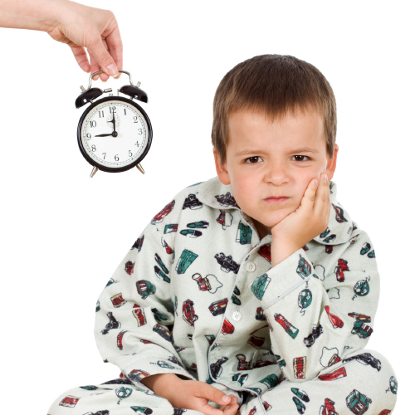
Behavioral Insomnia in Children
Sleep-onset association type (e.g., child requires parent as sleep comfort item)
Limit-setting type (e.g., bedtime refusal/defiance)
Notes:
Prevalence: 2-7%, risk increases with age
Contributing factors: family history, low serum ferritin levels (iron stores), older age
80% of individuals with RLS exhibit periodic limb movements during the night, which can also disrupt sleep
Individuals on antipsychotics are at risk for akathisia as a side effect (agitation, restlessness, need to move) which can mimic RLS in the evenings

Slide 17
Behavioral Insomnia in Children
Sleep onset association type includes each of the following:
Falling asleep is an extended process that requires special conditions
Sleep onset associations are highly problematic or demanding
In the absence of the associated conditions, sleep onset is significantly delayed/disrupted
Nighttime awakenings require caregiver intervention for the child to return to sleep
Limit-setting type includes each of the following:
The individual has difficulty initiating or maintaining sleep
The individual stalls or refuses to go to bed at an appropriate time or refuses to return to bed following a nighttime awakening
The caregiver to establish has difficulty establishing limits and enforcing routines surrounding bedtime and sleep
American Academy of Sleep Medicine (2005)
Notes:
Prevalence: 2-7%, risk increases with age
Contributing factors: family history, low serum ferritin levels (iron stores), older age
80% of individuals with RLS exhibit periodic limb movements during the night, which can also disrupt sleep
Individuals on antipsychotics are at risk for akathisia as a side effect (agitation, restlessness, need to move) which can mimic RLS in the evenings

Slide 18
Sleep-Wake Disorders in DSM-5 (APA, 2013)
Circadian Rhythm Disorder, Ex: Delayed sleep phase type:
Persistent pattern of sleep disruption primarily due to a misalignment between an individual’s circadian rhythm and the sleep-wake schedule required by an individual’s physical, social, or professional schedule
Delayed sleep onset and awakening times, with an inability to fall asleep at a conventional time
Sleep disruption leads to excessive sleepiness and/or insomnia
Sleep disturbance causes clinically significant distress or impairment in social, occupational, or other important areas of functioning
More than 10% of children with ASD found to have circadian rhythm-related sleep difficulties; elevated daytime and lower nocturnal melatonin; “free running” reported to be more common in ASD
There is research to support abnormal melatonin synthesis and increased circadian rhythm disorders in ASD and Smith-Magenis syndrome
Notes:
Other types of Circadian Rhythm Disorders:
Advanced sleep phase type (advanced sleep onset, difficulty staying awake)
Irregular sleep-wake type (variable sleep onset pattern)
Non-24-hour sleep-wake type (consistent daily drift) = “free runners”
Rare (<1% in general population), but shoots up to 7% in adolescents.

Slide 19
Sleep-Wake Disorders in DSM-5 (APA, 2013)
Obstructive sleep apnea hypopnea:
PSG evidence showing at least 5 obstructive/halted breathing events per hour of sleep with occurrence of nocturnal breathing disturbances (snoring, gasping, pauses in breath) and daytime fatigue not attributable to another medical condition
Or PSG evidence of 15 or more obstructive/halted breathing events
Specify as mild (apnea hypopnea index <15), moderate (API = 15-30), or severe (API >30).
50%-100% incidence of OSA among individuals with Down Syndrome due to midline differences, hypotonia, weight, and large neck circumference
60% of children with Down Syndrome show abnormal sleep studies by age 4 years
Notes:
Apnea = suspension of breathing
Hypopnea = shallow, slowed breathing
API – measured per hour of sleep study
OSA: 1-2 % of children; up to 20% of older adults
In individuals with obesity, the rate goes up to 77%
Higher risk among individuals who are overweight, have low muscle tone, or who have Down syndrome or Prader-Willi syndrome (due to midline abnormalities, “floppy airways”).

Slide 20
Sleep-Wake Disorders in DSM-5 (Parasomnias)
Non-rapid eye movement sleep arousal disorders:
Recurrent episodes of incomplete awakening from sleep, usually occurring during the first 1/3 of the major sleep episode, involving either sleepwalking or sleep terrors
Little or no dream imagery is recalled and amnesia for the episode is present
Sleep disturbance causes clinically significant distress or impairment in social, occupational, or other important areas of functioning
Coexisting mental/medical disorders or substance use do not explain the episodes
54% of children with ASD show early nighttime awakening; higher rates of parasomnias reported compared to typically developing peers
Notes:
Parasomnias = involve abnormal movements, behaviors, emotions, perceptions, and dreams during sleep phases.
Isolated episodes of parasomnias are very common (10-30% of children have at least one); actual disorder is in 1-5% of children.
Sleep terrors are different from nightmares, and there is a separate category for Nightmare Disorder
Occasional nightmares are more common occurring in about 30% of children.
Contributing factors: sleep deprivation, family history

Slide 21
Practice Guidelines (for ASD)
Screen all children for insomnia/sleep difficulties
Screen for potential contributing factors/medical issues
Determine need for therapeutic intervention
First line: education and behavior strategies
Assess indication for pharmacological therapy
Follow-up to evaluate effectiveness and tolerance of interventions
Malow et al., 2012

Slide 22
Screening & Assessment
Clinical interview/sleep history
Sleep diaries (parent-report, self-report)
Actigraphy
Polysomnography (PSG)

Slide 23
Sleep Interviewing & History
1. Sleep schedule & routines:
Dinner time, evening activities, and bedtime routine
Are any bedtime strategies used? (visuals, tokens, etc.)
Sleep schedule (weekday, weekend, summer bedtimes)
Bedtime (setting, who/what is present during sleep onset)
Average time of sleep onset latency (subjective estimate)
Strategies for falling asleep, attitude towards sleep (anxiety)
Wake times, mode of awakening (difficulty getting up)
Notes:
Sleep onset latency = the time it takes you to fall asleep (under 30 minutes is normal)

Slide 24
Sleep Interviewing & History
2. Presenting sleep difficulties:
Difficulty falling asleep (refer to sleep onset latency)
Circadian timing (when do you feel most alert?)
Restless legs syndrome (odd leg sensations, periodic limb movements)
Parasomnias (nightmares, night terrors, bruxism, enuresis)
Nighttime awakenings (When? Duration? Return to sleep?)
Sleep disordered breathing (gasping, pauses in breath)
Narcolepsy symptoms (daytime sleepiness, cataplexy, hypnagogic hallucinations, sleep paralysis)
Notes:
Restless legs syndrome: Ask children to describe or draw feelings in legs (e.g., creepy crawly, spaghetti legs). 80% of people with RLS also experience periodic limb movements during sleep.
Timing of nighttime awakenings: Sleep terrors happen earlier within first 2-3 hours of sleep when children transition from deep stage sleep to lighter REM sleep (a terror occurs as a disruption with this transition.
Hypnagogic hallucinations are hallucinations that occur during transitions from sleep to wakefulness and visa versa; may be vivid or bizarre.
Simple checklists can be helpful to quickly screen for these symptoms.

Slide 25
Sleep Interviewing & History
3. Other considerations:
Medical history
Developmental history
Psychiatric history (mood-related symptoms)
Nutrition & diet
Substances (caffeine intake, nicotine use)
Recent stressors/changes in routine
Current medications (antidepressants, decongestants)
Family history
Participation in therapy
Past sleep interventions
Notes:
Changes in routine: Many kids came into the sleep clinic in the Spring and in the Fall for two reasons: (1) school transitions; (2) daylight savings time.

Slide 26
Sleep Interviewing & History
4. Family-centered topics
Family priority of sleep difficulties
Willingness/ability to implement behavioral interventions
Co-sleeping/family sleeping arrangements
Notes:
Changes in routine: Many kids came into the sleep clinic in the Spring and in the Fall for two reasons: (1) school transitions; (2) daylight savings time.

Slide 27
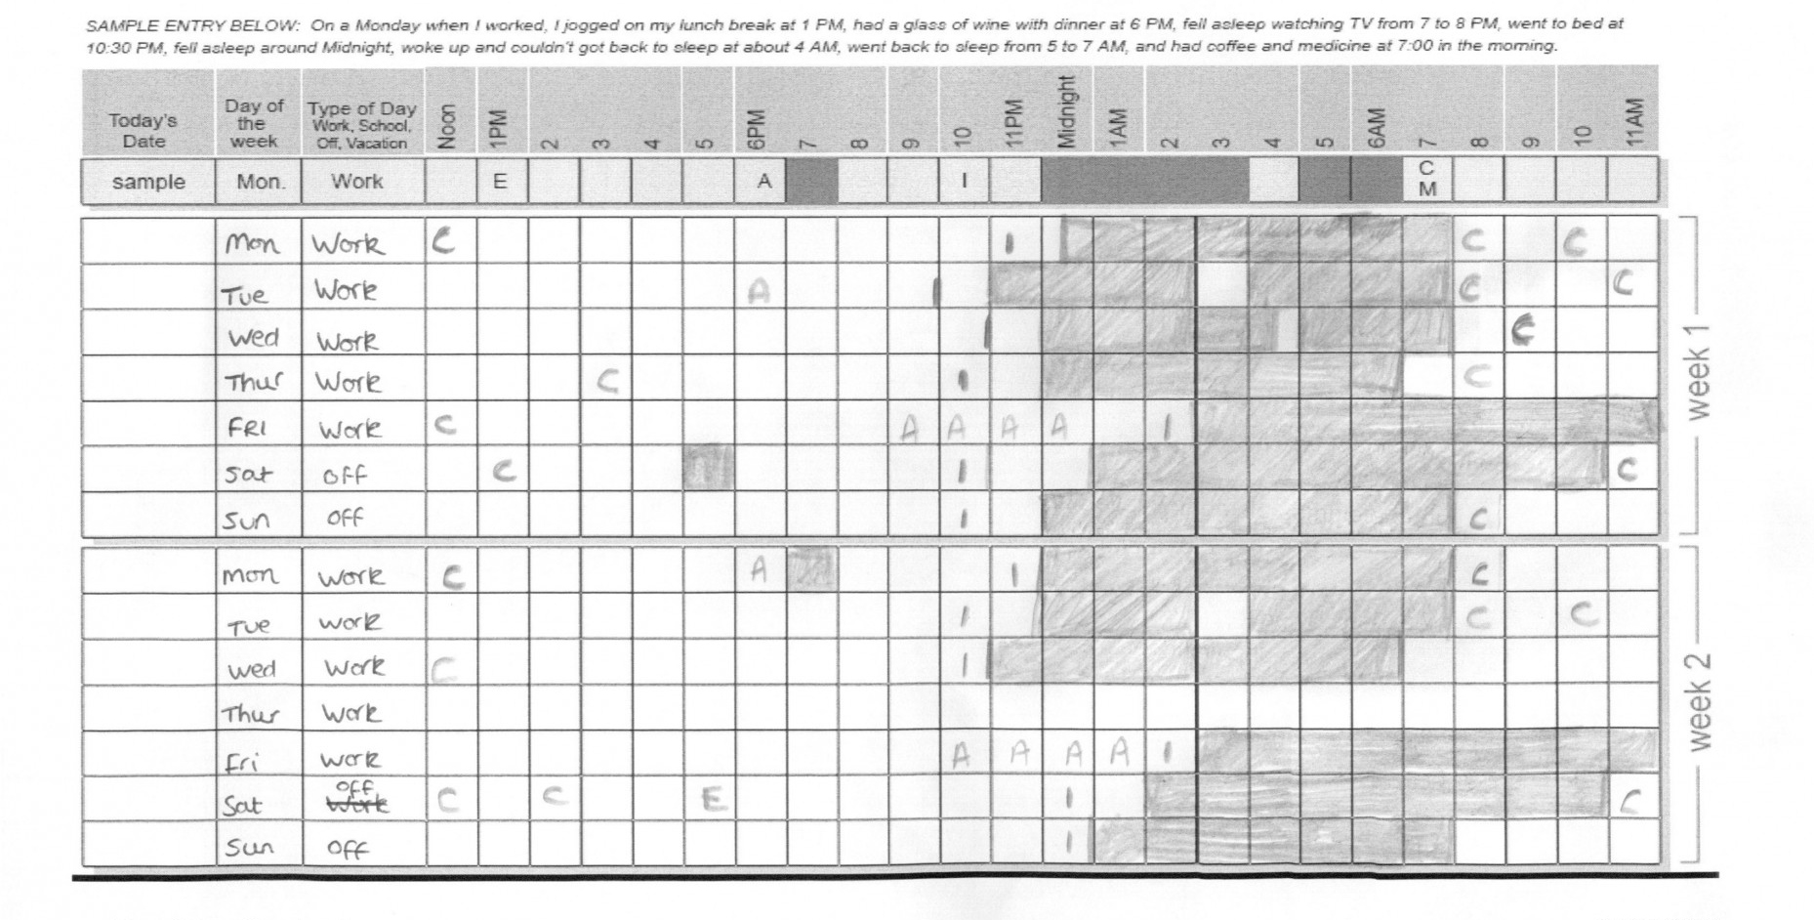
Sleep Diaries
Notes:
C=caffeine
E = exercise
M = medicine
A = Alcohol
Line | = in bed
Shaded = sleep
Example of mild insomnia

Slide 28
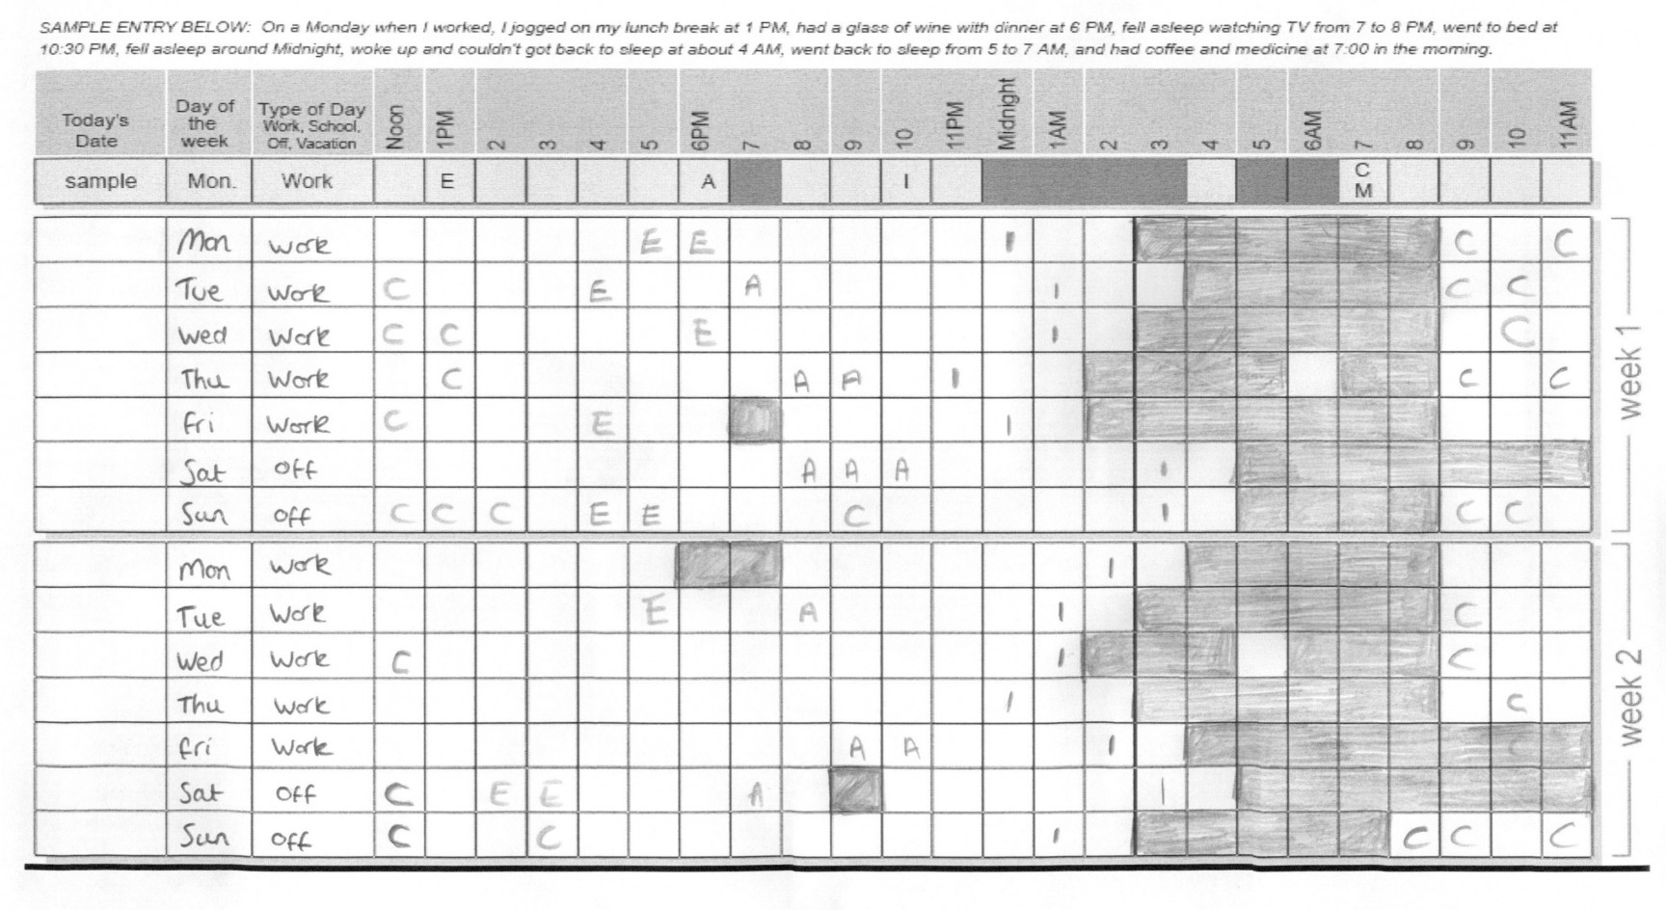
Sleep Diaries
Notes:
Example of more significant insomnia

Slide 29
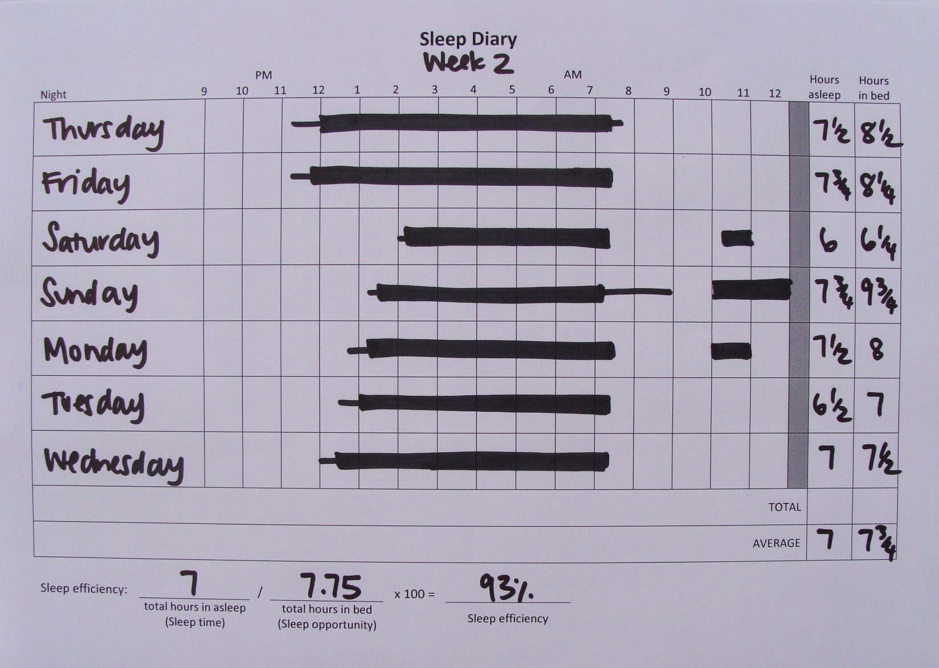
Sleep Diaries
Notes:
Typical sleep for a young adult

Slide 30
Sleep Diaries
Problems with sleep diaries?

Slide 31
Sleep Diaries
Problems with sleep diaries?
Can be subjective (individuals are asked to avoid watching the clock)
Younger children and some individuals with developmental disabilities may not be accurate reporters
Caregivers may not be aware of their children’s sleep patterns throughout the night

Slide 32
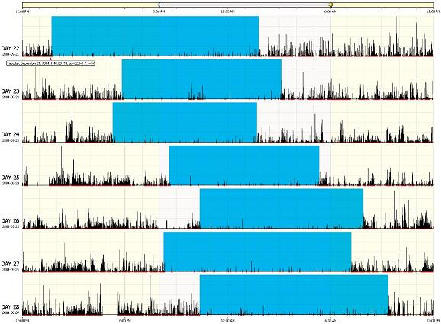
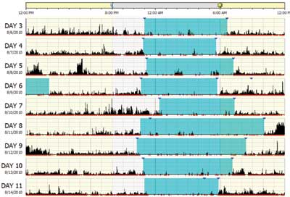
Actigraphy
Accelerometer measures movement to assess sleep-wake patterns (less accurate than PSG)
Easy to use, can record multiple nights of data
More affordable tool for researchers
Invasive for children
Insurance reimbursement varies (experimental method)
Notes:
Blue section = time in bed
Black marks = activity/movement (interpreted as wakefulness or restlessness)
Left-side data is from someone with a circadian rhythm problem
Right-side data shows more typical sleep pattern
Discuss use of Fitbit

Slide 33
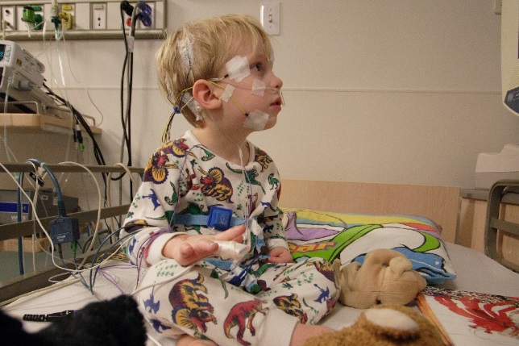
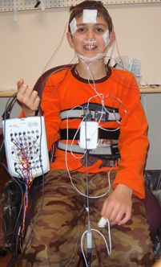
Polysomnography (PSG)
Gold standard tool for assessing sleep
Can identify modifiable factors affecting sleep (e.g., apnea)
Typically done over one night in lab-setting
Expensive tool for researchers
Can be invasive for children and difficult to tolerate
May not yield findings
Notes:
Children with developmental disabilities and younger children often require behavioral intervention to adapt and habituate to PSG equipment.

Slide 34
Behavioral Interventions for Bedtime Difficulties
Interventions for general population are indicated for IDDs
May need to add additional supports to enhance/prepare
May require more planning and persistence when implementing
Should consider additional factors that may need to be addressed
Notes:
Half-life of caffeine is 5 – 6 hours! Make sure to cut out caffeine by the early afternoon.

Slide 35
Behavioral Interventions for Bedtime Difficulties
Maintaining Good Sleep Hygiene:
Consistent sleep/wake schedules every day
Predictable bedtime routine/visuals/timers/firm expectations
Environmental changes (comfort of room, limit light exposure, remove electronics)
Decrease nap time in older children
Avoid caffeine or stimulating activities prior to bed
Increase physical exercise during the day
Address safety issues
Discuss potential medication side effects with prescribing physician
Notes:
Half-life of caffeine is 5 – 6 hours! Make sure to cut out caffeine by the early afternoon.

Slide 36
Behavioral Interventions for Bedtime Difficulties
For Sleep-Onset Association Problems:
Maintain good sleep hygiene
Full extinction methods (“cry it out”)
Gradual extinction procedure (check-in, check-out procedure)
Parental fading (move toward the door)
Proactive scheduled awakenings
Use transitional (comfort) objects
Reward systems
Bedtime pass
“Sleep fairy”
Notes:
Bedtime Pass: can be redeemed for token or prize in the morning if unused during the night.

Slide 37
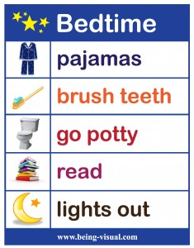
Behavioral Interventions for Bedtime Difficulties
For Limit Setting Problems
Maintain good sleep hygiene, focusing on consistent and relaxing bedtime routine
Use visual supports and schedules to reinforce routine
Transition cues (timer nightlight)
Reward systems

Slide 38
Behavioral Interventions Example Reward Chart
Notes:
Anything you would change about this chart?
-positively word goal at bottom: “Fell asleep all by myself”

Slide 39
Cognitive-Behavioral Interventions for Insomnia
Spielman’s 3-P Model of Insomnia:
predisposing factors (biological, personality)
precipitating events (stressful or disruptive events to sleep routine)
perpetuating mechanisms (anxiety, daytime napping, negative sleep associations)
Goal is to increase sleep efficiency (SE) gradually, so you might initially decrease time spent in bed:
SE = (time sleeping / time in bed) x 100%
Cognitive and behavioral strategies are used to address sleep-related anxiety and difficulties with sleep onset
Notes:
Working with a therapist on building coping skills, addressing anxiety, and building a positive bedtime routine can be helpful.

Slide 40
Cognitive-Behavioral Interventions for Insomnia
Select routine sleep and wake times based on general sleep drive
Stimulus control (the bed is a place for sleeping): for trouble falling asleep, get out of bed and engage in relaxing activity until tired
Environmental control (limit exposure to bright lights in the evening, room temperature should be cool at night)
Avoid misguided compensatory strategies (avoid daytime napping, caffeine intake, or alcohol use)
Keep sleep log, but avoid “clock watching”
Practice relaxation strategies at bedtime
Practice anxiety management strategies at other times (worry log, thought record)
Notes:
CBT for insomnia is an evidenced-based time-limited therapy.
Jack Edinger (University of Denver) created the Treatments That Work Manual

Slide 41
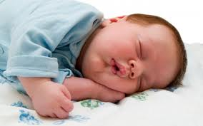
Behavioral Interventions for Nighttime Awakenings
For infants (6-12 months):
Dream feed
Lengthen interval before feeding/scheduled awakenings
Decrease duration of feeding
After weaning, establish parameters for putting baby back to sleep
Extinction procedures (sometimes require a “parent vacation”)
For children:
Consistent sleep schedule
Limit naps (increase sleep drive)
Firm limits/systematic ignoring
Coping strategies/soothing items
Bedtime pass
Extinction procedures
Notes:
Set appropriate expectations (night waking and feeding are developmentally appropriate for newborns up to 6 months

Slide 42
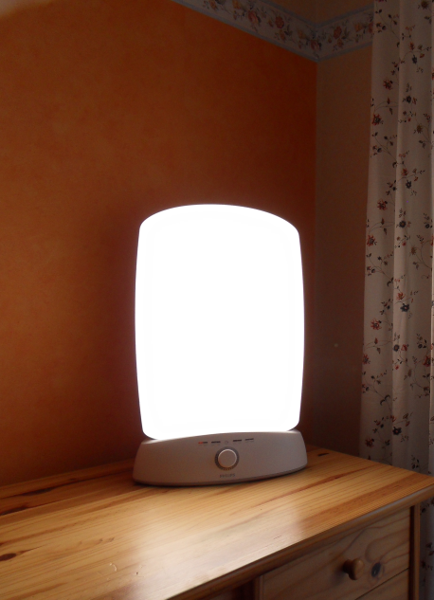
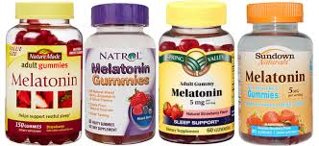
Interventions for Circadian Rhythm Problems
Chronotherapy (resetting/shifting internal clock)
Melatonin
Light Therapy (light box, dawn simulator)

Slide 43
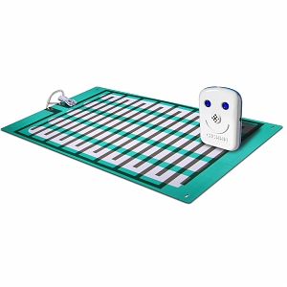
Behavioral Interventions for Enuresis
Bedtime toileting routine
Nighttime pull-ups
Continence training
Bed-wetting alarm
http://bedwettingstore.com/
Notes:
Important to ask about bed-wetting for individuals of all ages, since this is an embarrassing problem that has some simple solutions.

Slide 44
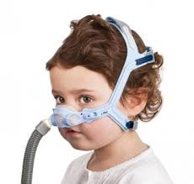
Medical Interventions
Medications to treat sleep disruption (clonidine, gabapentin, etc.)
Melatonin supplement (liquid and pill forms)
Iron therapy to treat restlessness and parasomnias (increase levels of serum ferritin)
Continuous positive airway pressure (CPAP) devices (sometimes require habituation training and compliance intervention)
Notes:
Examples of medications to address sleep onset/maintenance:
long-acting clonidine
Gabapentin
tricyclic anti-depressants (rarely)
Trazodone (rarely)
mirtazapine (rarely), atypical antipsychotics only if other behaviors or diagnoses warrant this—should not be used as treatment for insomnia alone)
Avoid “Sedative/hypnotics” like zolpidem(Ambien) with rare exception because of unexpected severe behavioral/emotional side effects
– Avoid benzodiazepines unless they are also being used to treat a known seizure disorder as they don’t generally aid sleep architecture and may have tolerance and withdrawal issues over time.
Low doses of melatonin early in the evening can help with sleep onset and to shift individual’s sleep drive to a slightly earlier time. Melatonin production naturally slows during puberty. Some parents have concerns regarding children’s development and growth on melatonin (hormone), but research evidence does not indicate any negative side effects.

Slide 45
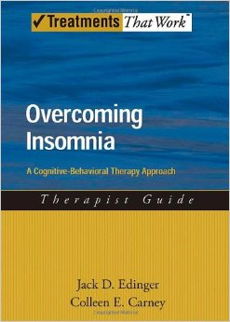
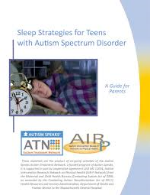
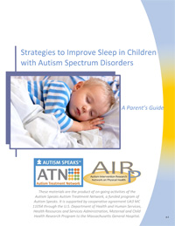
Resources
Overcoming Insomnia by Jack Edinger & Colleen Carney
Sleeping Through the Night by Jodi Mindell
Autism Speaks’ Strategies to Improve Sleep in Children with Autism Spectrum Disorders: A Parent’s Guide
Autism Speaks’ Sleep Strategies for Teens with Autism Spectrum Disorder: A Parent’s Guide

Slide 46
References
American Sleep Association (ASA):
www.sleepassociation.org
National Sleep Foundation:
https://sleepfoundation.org
Cohen, S. et al. (2014). The relationship between sleep and behavior in ASD: A review. Journal of Neurodevelopmental Disorders. Doi: 10.1186/1866-1955-6-44
Chiu, S. & Pataki, C. Pediatric sleep disorders. Retrieved from: http://emedicine.medscape.com/article/916611-overview
University of Michigan Health System. Your Child Development & Behavior Resources: Sleep problems. Retrieved from: http://www.med.umich.edu/yourchild/topics/sleep.htm#childrens
American Psychiatric Association: Diagnostic and Statistical Manual of Mental Disorders, Fifth Edition. Arlington, VA, American Psychiatric Association, 2013.

Slide 47
Additional References
Fricke-Oerkermann, L. et al. (2007). Prevalence and Course of Sleep Problems in Childhood. Sleep, 30: 1371-1377.
Malow, B. A., Byars, K., Johnson, K.,Weiss, S., Bernal, P., Goldman, S.E., et al. (2012). A practice pathway for the identification, evaluation, and management of insomnia in children and adolescents with autism spectrum disorders. Pediatrics, 130(Suppl. 2), S106–S124.
Mannion, A., & Geraldine, L. (2014). Sleep problems in autism spectrum disorder: A literature review. J Autism Dev Disord, 1: 101-109.
Stein M.A., Mendelsohn, J., Obermeyer, W.H., Amromin, J., & Benca, R. (2001). Sleep and behavior problems in school-aged children. Pediatrics, 107:1–9.
Turk, J. (2016). Melatonin supplementation for severe disturbance in young people with genetically determined developmental disabilities: Short review and commentary. J Med Genet, 40: 793-796.

Slide 48
Questions?

